Slide 1
Event Sourcing and Event Storage with Apache Kafka®

Slide 2
What’s Covered
1 Thinking in Events
2 Storing Data as Events
3 Why Store Events?
4 Command Query Responsibility
Segregation (CQRS)
5 Hands On: Trying Out Event Sourcing
with Confluent Cloud
6 Incorporating Event Storage into Your
System
7 Event Sourcing vs. Event Streaming

Slide 3
Thinking in Events
Notes:
Welcome to this course on event sourcing and event storage with Apache Kafka. In it we’ll learn about how events can be used as a storage model for the applications we build, be they individual applications or an ecosystem of microservices.
In this first module we’re going to introduce a different way of thinking about system design than the more traditional one you may be used to.

Slide 4
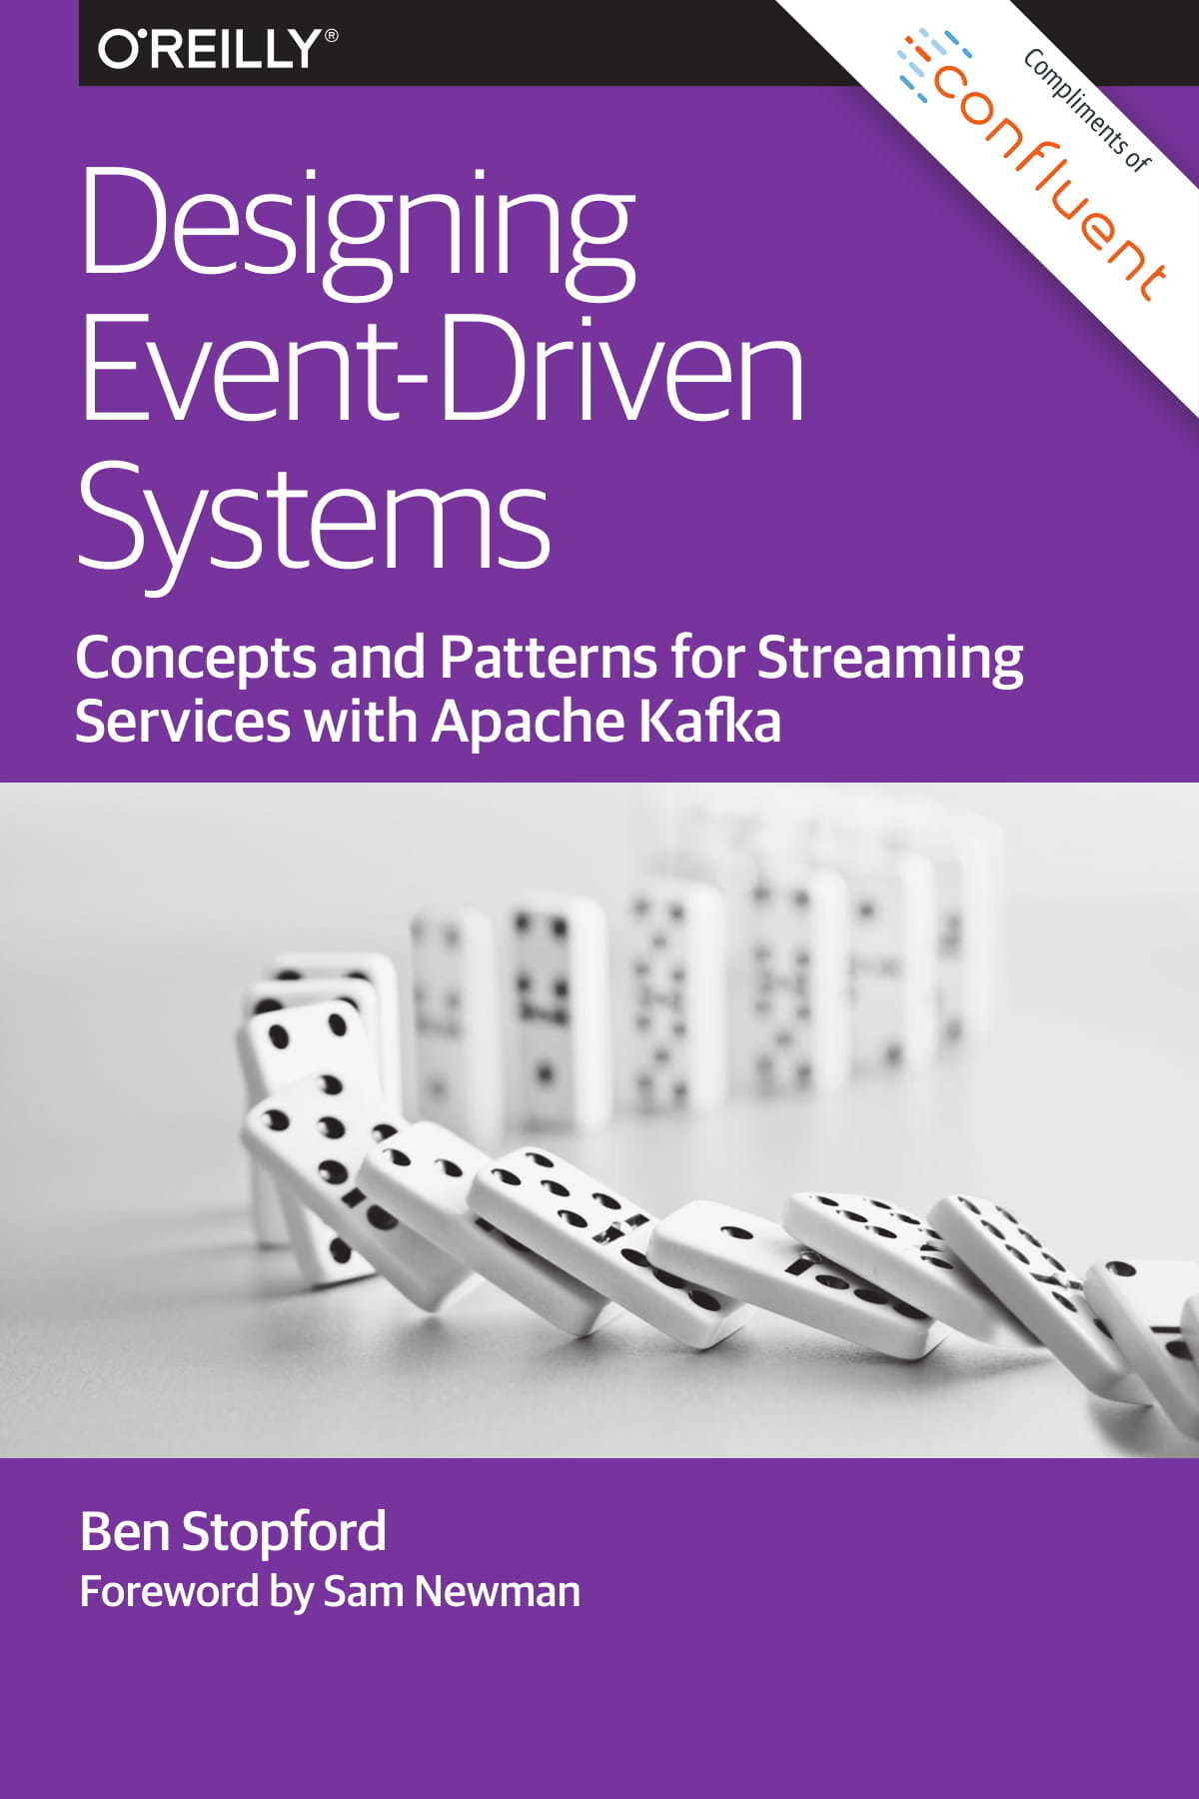
Accompanying Text
Section 2 of Designing Event Driven Systems, O’Reilly 2018
https://cnfl.io/deds-book
Notes:
This course accompanies the book Designing Event Driven Systems. If you’d like to look further into the subject matter there is a link below where you can download the book for free.

Slide 5
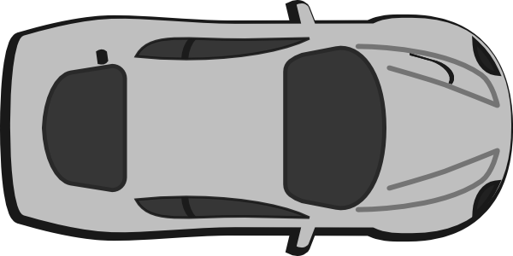
Computer Systems Model the Real World
in Software
Taking a taxi in the real world
Taking a taxi modelled in software
?
GEOSPATIAL
MATCHING
ROUTE
RE-PLANNING
Notes:
When you design and build a software system, you’re creating a model that describes a real world system. The real world system can be anything. Someone booking a taxi, buying a new pair of high tops, completing a financial transaction, in fact just about anything.
To build your model you need some kind of coordinate system which you can use to map the real world into your software.
This is analogous to the way science models the outside world using mathematics.

Slide 6
Similar to Coordinate Systems in Physics
Distance
Y
Angle
X
Polar Coordinates
Rectangular Coordinates
Notes:
In mathematics the two dominant coordinate systems are polar coordinates and rectangular (or cartesian) coordinates.
In polar coordinates you model a position by an angle and a distance, much like a fighter pilot might communicate a bogey being half a mile off at 4 o’clock. In cartesian coordinates you model a position using two perpendicular dimensions like making a point on a map using longitude and latitude.
All problems you may face can be solved in either coordinate system, but some problems are a much better fit for one vs. the other. For example modelling the motion of the planets around the sun is much simpler using the polar coordinate system - the maths just works out better!

Slide 7
Computer Systems Model the Real World
in Software
Taking a taxi in the real world
Notes:
Similarly, the design of software systems has two coordinate systems: state-based and event-based. For example, a state-based model of a taxi cab system would use a database and synchronous network calls to coordinate the state in the system.

Slide 8
Computer Systems Model the Real World
in Software
Using an event-based
design
Taking a taxi in the real world
Using a state-based design
GEOSPATIAL
MATCHING
ROUTE
RE-PLANNING
Notes:
The event-based model would use continuous and asynchronous streams of immutable events.
You can solve pretty much any problem you might face with either type of model but just like in mathematics, some problems suit one modelling approach better than the other. In this course you’re going to get familiar with this second form: modelling with events using data-at-rest and data-in-motion techniques: event sourcing, CQRS, event streaming, etc.

Slide 9
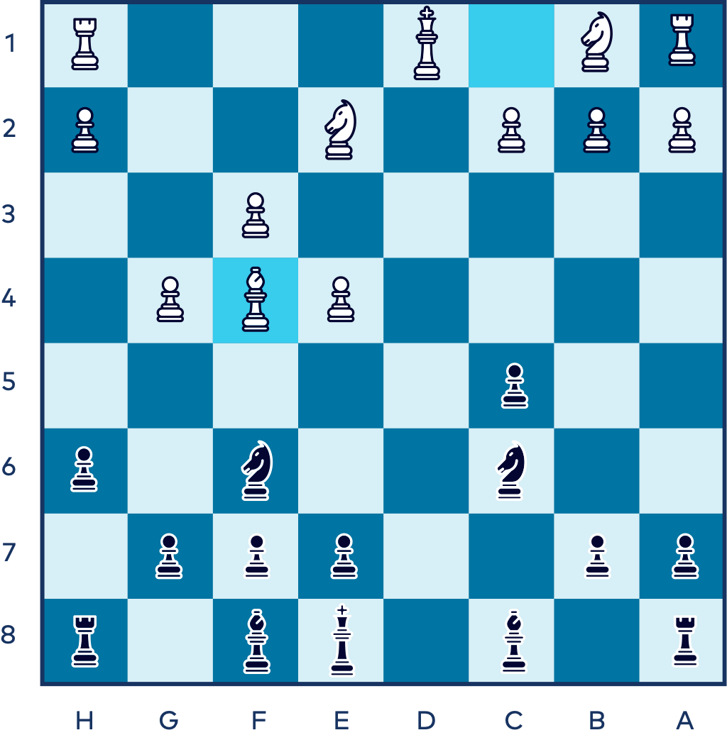
Notes:
A good place to start this process is to think about a chess game. Say we are mid-game and we want to save the position of all the pieces. Chess is another good example of something that offers us two coordinate systems that achieve the same result, the positions of all the pieces, but achieved in wildly different ways.

Slide 10
State-Based
The coordinates of each piece on the board
King (White) | E1
Queen (White) | /
Bishop 1 (White) | F1
Bishop 2 (White) | F4
Rook 1 (Whilte) | E2
...
Notes:
In the first method you go through all the pieces on the chess board, one by one, and record the their position as x and y coordinates. So White King is at coordinates E1, White Rook 1 is at coordinates e2, and so on.
We’re essentially taking a kind of snapshot of the state of the board which can be saved for later and this is exactly analogous to how state-based modelling works using a database. We record the current position of all the actors in the system and store those positions in a database table.

Slide 11
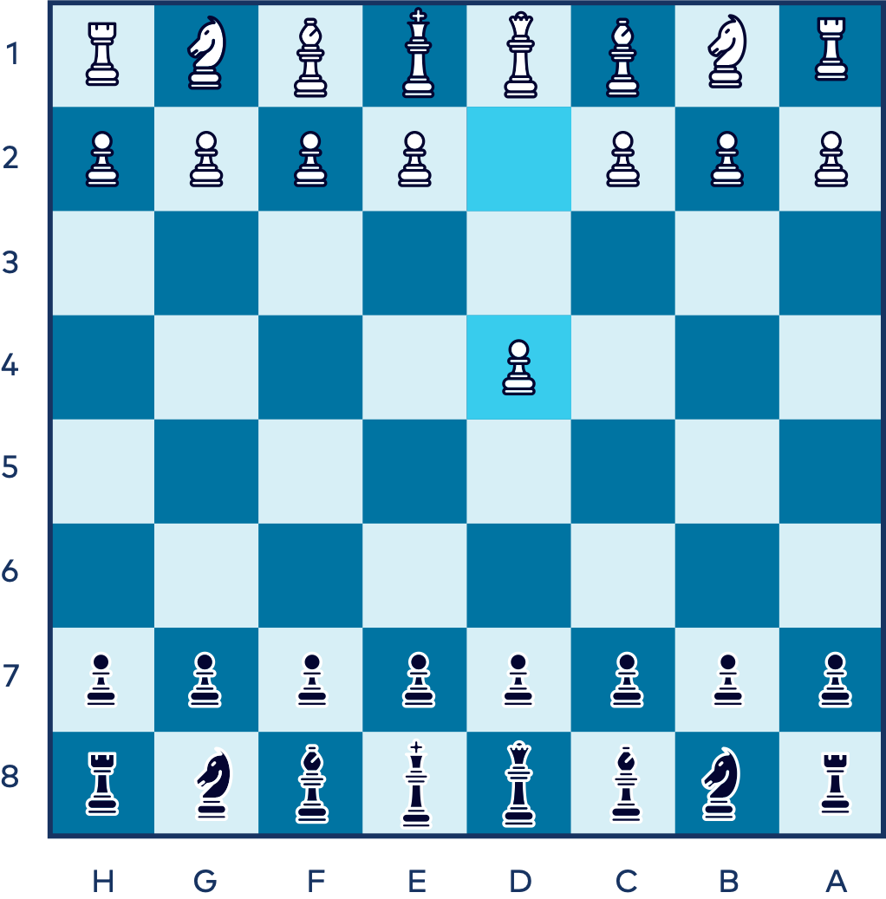
Event-Based
The series of moves/transitions made during the game
+
=
Starting Position
Moves
Ending Position
Notes:
Event-modelling is different. Rather than taking a snapshot of the whole board we notice that the game of chess has a known starting state: The starting position. From there a number of moves are made so if we replay all the moves, from the starting position, we can recreate any point in the game.
Each chess move is an event: A transition from one state to the next. The event doesn’t need to contain information about the positions of other pieces on the board (although there is nothing to stop it doing so). But, unlike the state-based approach, the whole stream of events is required to derive the current position.

Slide 12
Two Coordinate Systems in Software Design
State-Based: each state is a snapshot in time
Event-Based: each state is the culmination of a stream of events
Notes:
So in summary, we have two coordinate systems for modelling real world problems in software. One uses state and is coordinate based, the other uses events and is transition based.
You are likely very familiar with the state-based approach if you’re familiar with database development. But the event-modelling approach, although less popular, is better suited to many of today’s problems, particularly as systems get larger and incorporate a greater number of separate parts.
As a final point we should ask ourselves the question, why do I need this other approach at all? The answer lies in the chess game itself. If you use events, you naturally map out the game as it is played. This can be done with a database, but it’s far less natural to do so. Transitions and events work best when you’re modelling how something evolves over time.

Slide 13
GET STARTED TODAY
Confluent Cloud
cnfl.io/confluent-cloud
PROMO CODE: EVENTS101
$101 of free usage
Notes:
The course will have exercises that will have you produce data to and consume data from Confluent Cloud. If you haven’t already signed up for Confluent Cloud, sign up now so when your first exercise asks you to log in, you are ready to do so. Be sure to use the promo code EVENTS101 when signing up to get the $101 of free usage that it provides.
Walk through signup process:
Initial page (name, email, etc.)
Click Start Free button
Check for confirmation email and click the link to continue
Page for guided tutorial comes up, we’ll skip that for now
Create Cluster page comes up, we can see different cluster types
Choose Basic cluster and click Begin configuration button
Cloud Provider settings: Choose GCP, US-Central1, single AZ
Review / launch page: review charges and give cluster a name
Click Launch Cluster
Cluster completed page comes up
Expand menu and choose Billing & payment, then click on Payment details
See that you have $400 in free Confluent Cloud usage Expand Promo code field
Enter promo code EVENTS101 for an additional $101 of free usage and click save
Back to Cluster completed page, click “I’m not ready yet, let me explore”
Explore our new cluster
The "promo code" must be activated before December 31st, 2024, directly within the Confluent Cloud billing interface. Once activated, the promo value will be available for consumption for 90 days, beginning on the date of activation. Promo value will automatically be applied to any usage charges incurred after activation. Any unused promo value on the expiration date will be forfeited. If you receive an invalid promo code error when trying to activate a code, this means that all promo codes have already been claimed.

Slide 14
Storing Data as Events
Notes:
Welcome to module 2 of the Event Sourcing course. In this module we’re going to cover what event sourcing is.

Slide 15
Customer | Product | #
Sanjana | Pants | 1
Sanjana | T-Shirts | 1
Sanjana | Hats | 1
Customer | Product | #
Sanjana | Pants | 1
Sanjana | T-Shirts | 1
Sanjana | Hats | 1
Database Table exactly matches what the user sees in their cart on the screen
DATABASE
Notes:
Let’s start with a simple example. Imagine we have an e-commerce application. A user, we’ll call her Sanjana, has added a few items to her shopping cart: a t-shirt, some pants, and a hat. The shopping cart is stored in a database table and that table looks just like the shopping cart does. The table has rows and columns stored in the database that exactly match the rows deployed on the screen when the user clicks their cart.
Adding a new item adds a new row to the screen and a new row to the database table. If you add more than one item the item count goes up on the screen and is saved to the database. This approach is known as the CRUD as you can Create, Read, Update or Delete any row in the table you wish. You should find this very familiar if you’ve used databases before.

Slide 16
Event Sourcing
Create - Read - Update - Delete
CRUD
Notes:
When we apply Event Sourcing we achieve the same goal – storing the shopping cart safely to disk–but in a different way. Like the CRUD method we can Create new entries and Read them back, but we never Update a value and we never Delete a value. The two destructive operations, the methods that delete or change data in the table, are not allowed. The lack of any destructive operations makes event source systems behave more like the version control systems you store your code in.

Slide 17
Event Sourcing Stores Events, then Derives
the “Current State View”
12.42
2 Pants added to cart
1 T-Shirts added to cart
1 Pants removed to cart
1 Hat added to cart
User Checked Out
Events
12.44
Customer | Product | #
Sanjana | Pants | 1
Sanjana | T-Shirts | 1
Sanjana | Hats | 1
Timeseries of User Activity
12.49
12.50
12.59
Summarize
Chronological Reduce
Notes:
The lack of destructive methods means event sourcing records every action a user makes as it happens and stores that action forever. Each action is an event and the collection of actions that build up over time are called event streams.
So, adding a new t-shirt to the shopping cart is an event. Adding another is another event. Checking out is an event. As the events build up they create a timeline of the user’s activity. We can see the user adding items, removing items, and finally checking out at different points in time in the event stream: a kind of customer journey tracking exactly what the customer did.
But the stream of events isn’t a great resource for reading the current state from. Say we want to know how many pants are in the shopping cart, that information is spread over multiple events - two add events and one remove event, all created at different times). Event sourced systems solve this problem by reading all the events into the client and performing a computation that derives the current state. In this case it’s a chronological reduce. By transforming the event view on the left into the table view on the right we can then display our shopping cart easily.
Finally, note how the event based view, on the left hand side of the image, has more information than the table view on the right. The transformation is unidirectional so you can go from events view to the table view but not back again as information is lost as we move left to right. This is why event sourcing is so powerful. It retains extra data about what really happened in the world. That would traditionally –if we’re using the CRUD approach- be thrown away.

Slide 18
Event Sourcing
Table of Contents
Persist Events
2 Pants added to cart
1 T-Shirts added to cart
1 Pants removed to cart
1 Hat added to cart
User Checked Out
App
Notes:
Let’s walk through how we actually do this in practice. First we store the events into a table in a database, or alternatively you can use Kafka. Basically, you create a table and append events in the order that they occur.

Slide 19
Event Sourcing
Customer | Product | #
Sanjana | Pants | 1
Sanjana | T-Shirts | 1
Sanjana | Hats | 1
1. Query Events
2 Pants added to cart
1 T-Shirts added to cart
1 Pants removed to cart
1 Hat added to cart
User Checked Out
App
2 Pants added to cart
1 T-Shirts added to cart
1 Pants removed to cart
1 Hat added to cart
User Checked Out
3. Summarize
2. Events Returned
Notes:
When you need to query for the latest shopping cart, you run a query that returns events, most likely aggregated by customer id or session id, and then you perform a “chronological reduce” to filter the events that are relevant for the view you’d like to serve. So the stream of 5 events is turned into the three rows of the more ‘traditional’ database table.
So, we got to see how event sourcing is different from traditional forms of data management because the source of truth is an event log rather than a table you can mutate. This may seem a little odd though. Why go to all that trouble. In the next module we’ll explain why storing data in an event-centric form like this is so valuable.

Slide 20
Why Store Events

Slide 21
Evidentiary
Accountants don’t use erasers (e.g. audit, ledger, git)
Notes:
In module 2 we discussed the basics of event sourcing. But, you might wonder: we’ve been building systems with traditional databases for decades, why should we change? Storing data as events rather than in mutable tables has three main advantages which we’re going to cover in this module.
The first is that events are evidentiary. So what does that mean, exactly? One reason is that events are immutable, they never change. So, unlike a database table where we update different rows with new values, events simply accumulate in an event log so we can feel safe in the knowledge that they can never ever change. This provides the perfect evidentiary basis for a system. One that allows you to look back at what happened at a previous time.
This approach is quite similar to the way accountants do double entry bookkeeping. A method where no numbers are changed, ever. Instead entries are always appended to the ledger. This is where the old adage “accountants don’t use erasers.” comes from. Accountants do this because it is evidentiary. If a calculation goes wrong for whatever reason they can always go back and figure out why because all the data for the previous steps remains present.
Being append only, event sourcing is similar. We can look back in time at the event log and figure out what really happened, or why things went wrong. This is a huge advantage when trying to figure out why a problem occurred or why some result has the incorrect figures.

Slide 22
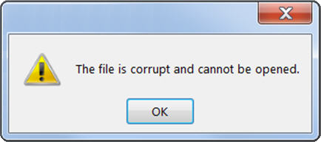
Recoverable
Recover corrupted data after a programmatic bug
Notes:
The second advantage of event sourcing is “replayability” and this is of particular importance for data systems.
To understand this, first consider the typical bug. Say a formatting failure in one of the input forms of a web application. This kind of bug is usually pretty easy to fix. You change the code, fix the bug, and release it.
But data related problems are often not so easy to fix. If your service does a computation, for example calculating interest on an account, and there is a bug in the computation, fixing and releasing the software likely isn’t enough. There will be a whole number of accounts whose data has been corrupted as a result of the bug.
But with an event based model the problem is simple to fix. First fix the bug, then rewind back to a point before the bug surfaced, and replay the old events. Thus both the software and the resulting data are fixed in one go.

Slide 23
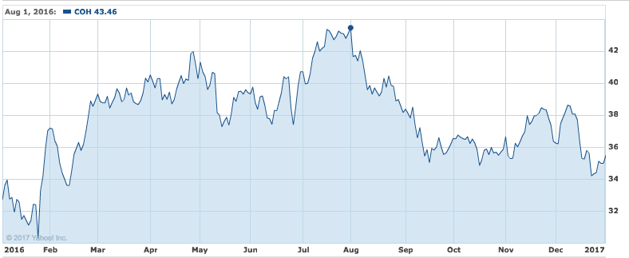
Insightful
Retain the original intent i.e. non-lossy (e.g. insight, metrics, ML)
Notes:
The final advantage comes from collecting such detailed event-level data which can feed it into analytics systems, whether for machine learning or for other types of analysis. To return to the shopping cart we used an example in module 2, using events to represent the cart gives an accurate, truthful record of the user’s behaviour.
Just like the chess game from module 1, we’re tracking the whole game, not just the end state. This let’s us solve useful problems that would be hard to solve otherwise. For example, figuring out why people aren’t buying that much in our shop at a particular time or within a given category.
This sort of analysis is possible with the event based model because the user’s shopping behaviour has been captured: i.e. exactly what they did: add to the shopping cart, remove from the shopping cart etc. This is in stark contrast to the what a CRUD data model is capable of: simply representing the end state.
So, storing data as events comes with significant benefits, but the context thus far has been simple monolithic applications. But what happens when our architectures grow larger? What happens when we incorporate event streaming as the storage media?
We’ll find all this out in Module 4 when we discuss Event Sourcing with Kafka.

Slide 24
Command Query Responsibility Segregation

Slide 25
Event Sourcing
Customer | Product | #
Sanjana | Pants | 1
Sanjana | T-Shirts | 1
Sanjana | Hats | 1
1. Query Events
2 Pants added to cart
1 T-Shirts added to cart
1 Pants removed to cart
1 Hat added to cart
User Checked Out
App
2 Pants added to cart
1 T-Shirts added to cart
1 Pants removed to cart
1 Hat added to cart
User Checked Out
3. Summarize
2. Events Returned
Notes:
As we covered in modules 1 and 2, event sourcing is an alternate means of storing data, using a log of events, rather than a table that is updated, read and deleted: that approach you’re no doubt familiar with from building systems that use databases in a traditional way. In event sourcing you create a table and append events to it as they occur, building up your event log. But with event sourcing, reading data has an additional step. First you read the data in (points 1 and 2 on the diagram) then you combine the events together at runtime, a kind of chronological reduce, that gets you the current state (as denoted in point 3 on the diagram).
The key point is that your data is physically stored in event-format, and you get all the benefits that come with that. The transformation step ensures your application logic also gets the data in the shape it needs: i.e. the tidy table-shaped description of what’s in your shopping cart.
One problem with this approach occurs when the number of events gets very large. Lots of events will make the reduce operation take a long time to execute and use more clock cycles in the process than you might be comfortable with. This probably isn’t an issue for a shopping cart but other use cases that incorporate larger numbers events, for example displaying the balance of a checking account, that’s a chronological reduce over your entire payment history, can take a while to compute. Not great if you’re clicking buttons and expecting things to happen then and there.
A solution to this problem is to do the computation when data is written, not at the time that it is read. This way each computation is done just once no matter how many times the value is read in the future. This is a technique called CQRS (Command, query responsibility segregation) and is by far the most common way in which event sourcing is implemented in real world applications. Let’s look at an example.

Slide 26
CQRS is a Pragmatic Alternative
2 Pants added to cart
1 T-Shirts added to cart
1 Pants removed to cart
1 Hat added to cart
User Checked Out
App
App
Customer | Product | #
Sanjana | Pants | 1
Sanjana | T-Shirts | 1
Sanjana | Hats | 1
Query Shopping Cart
Record User Events
2 Pants added to cart
1 T-Shirts added to cart
1 Pants removed to cart
1 Hat added to cart
User Checked Out
KAFKA TOPIC
Events are the Storage Model
ksqlDB
Read Time
Summarize Events
Write Time
Notes:
CQRS implementations always have two sides, a write-side and a read side. When we implement CQRS with Kafka, it is Kafka that provides the segregation between the two sides. In the write-side, on the left of the figure, you send commands or events which are stored reliably. The read-side, on the right hand side of the figure, is where you run queries to get data back. Unlike in the event sourcing case, the translation between event format and table format now happens at write time, albeit asynchronously.
In a database both of these concerns are conflated into a single layer. CQRS segregates the two from one another, hence the name: Command Query Responsibility Segregation.
Segregating reads from writes has some notable advantages. We get the benefits of event-level storage, as we discussed in module 3. We also get much higher performance as the write layer and read layer are decoupled. Of course this is a trade off and there is a price to be paid for both fast reads and writes: The system becomes eventually consistent, so a read might not be possible immediately after an event was written. This is something that must be taken into account when designing the system.
To implement CQRS with kafka we write directly to a topic creating a log of events. This is a fast mechanism for storing data compared to writing to a database which has indexes that must be updated – a time consuming operation. The events are then pushed from Kafka into a view on the read side from where they can be queried. The chronological reduce we discussed previously is performed before the data is inserted into the view.
This process makes the event log the system of record. The read-optimized view is created to specifically suit the use case we have. If we have multiple use cases with different read requirements, it’s common to create multiple views for these different use cases all from the same event log.
To ensure this is possible, events should be stored in an infinite retention Kafka topic so they’re available to these different use cases, should the read side need to be rebuilt or a new view created from scratch.
To physically implement CQRS you can use Kafka with Kafka Connect and a database of your choice, or you can simply use Kafka with ksqlDB. here ksqlDB performs both the required streaming computation–the chronological reduce–as well as materializing the view we read from, all within one, tidy package.
Note that, in contrast to the original event sourcing example, the reduce computation is done at write time not read time. So as we write a new event, the effect of that event is immediately incorporated in the view. This means the contents of the shopping cart are calculated once, and updated every time you add, remove or delete an item from the shopping cart, much like you might use a regular database. However, unlike a database, all the events are held in the event log in Kafka, preserving all the wonderful event-level detail.
Now you’ve got all the basics, it’s time to try this out, and you can can do this in a few minutes using Confluent Cloud. Just follow the steps in the next module and you’ll create your first event sourcing application.

Slide 27
Hands On: Trying Out Event Sourcing with Confluent Cloud

Slide 28
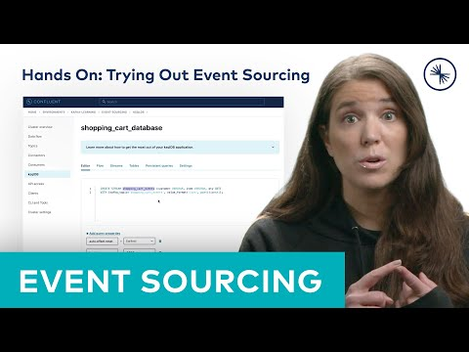
Hands On: Trying Out Event Sourcing with Confluent Cloud
Notes:
0:05 Open the shopping cart database.
0:15 Set two configuration parameters. The offset reset should be set to “earliest”.
0:25 Set the parameter ksql.streams.interval.milliseconds which we’ll configure to 3 seconds.
0:38 Create a stream to hold our shopping cart events.
0:45 Run query and confirm the shopping cart event stream was created.
1:09 Select the first statement and Run that query.
1:12 Run the “Select” statement and confirm 4 events were returned.
1:20 We create the ksqlDB query that transforms the events into the summary table. To do this we must include a SUM on the quantity field with an associated group by that aggregates the events by item.
1:33 The result will be a table that reflects how many items are in the shopping cart right now. So the removals should cancel the items we added.
1:40 Run that query.
1:44 Current Shopping Cart summary table has been created
1:49 Run a query against the table. Select * from current shopping cart emitting changes. So we expect to see three records not four. One record per item. More than one of the same events get summarized into one row.
2:11 So in summary, we simulate events coming from the user adding and removing items from their shopping cart. We store those events in a Kafka Topic. We then create a streaming query to transform them into a table in ksqlDB. Finally, we query the summary table to get the contents of the shopping cart back to our application

Slide 29
Incorporating Event Storage Into Your System

Slide 30
Even with CQRS, Event Sourcing is Harder
CRUD System
CQRS
App
App
View
KAFKA TOPIC
Notes:
Based on the previous modules, event sourcing should sound quite appealing. You get an evidentiary log. You get fast reads and fast writes. You get a behavioural view that can be used for analytics. So what’s the catch?
Event sourcing is harder to implement that traditional state-based methods for a number of reasons. In a traditional system there is often just an application and a database. In a CQRS system there is typically at least one more moving part: The Kafka topic that separates the write side of the application from the read side.
A second complexity is that, as applications evolve over time the data model changes also. This leads to events with many different versions of the same schema being stored inside a single topic, some schemas old, some more recent. This is similar to what happens in schemaless databases like Cassandra or MongoDB.
As the number of schemas increases, different parsing code must be added to understand each one. This is a perfectly valid strategy for building software but it adds complexity to the system nonetheless.
Finally, any CQRS-based system is eventually consistent, meaning you can’t necessarily read your own writes.
So there’s a little bit of extra complexity with CQRS, but the model works well for many different kinds of use cases.

Slide 31
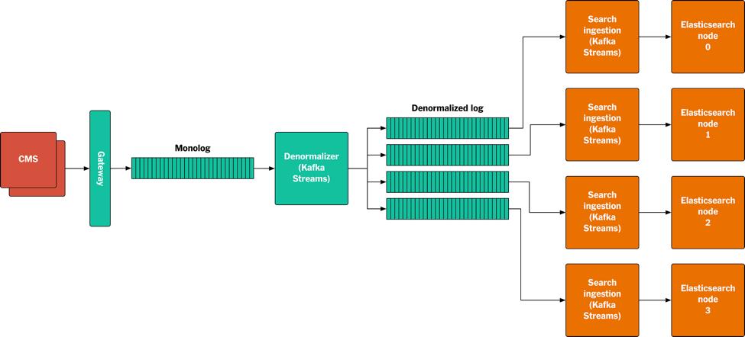
New York Times Website
Denormalized into “Content View”
Source of Truth
Every article since 1851
Normalized assets
(images, articles, bylines, tags all separate messages)
https://www.confluent.io/blog/publishing-apache-kafka-new-york-times/
Notes:
A good example of this working well is the New York Times website. This application stores every single edit, image, article, and byline from the newspaper right back to 1851. All this data is stored in a single Kafka topic.
The raw data is stored as events, which are summarized into tables to be delivered on the website. This use case works well because the CMS, where the content originates, doesn’t need to be immediately consistent with the serving layer. So being eventually consistent works well.

Slide 32
Change Data Capture
Evidentiary
Replayable
Analytics
CDC
KAFKA TOPIC
Customer | Product | #
Sanjana | Pants | 1
Sanjana | T-Shirts | 1
Sanjana | Hats | 1
2 Pants added to cart
1 T-Shirts added to cart
1 Pants removed to cart
1 Hat added to cart
User Checked Out
Notes:
But Event Sourcing isn’t the only approach we can take to provide event-level storage as our system of record. Change Data Capture (CDC) provides most of the same benefits without changing the underlying data model.
In the figure we have a mutable table in the database representing the shopping cart. A CDC connector pulls events from this table as rows are added or changed. These are pushed into a Kafka topic where they can be consumed by other systems.
Because CDC records changes at an event-level with get all the evidentiary benefits of event sourcing. Sadly, unlike event sourcing, the mechanism is not replayable.
However, the Outbox Pattern can be used as means to remedy to this.

Slide 33
Outbox Pattern
Evidentiary
Replayable
Analytics
CDC
Trigger
KAFKA TOPIC
Customer | Product | #
Sanjana | Pants | 1
Sanjana | T-Shirts | 1
Sanjana | Hats | 1
2 Pants added to cart
1 T-Shirts added to cart
1 Pants removed to cart
1 Hat added to cart
User Checked Out
Notes:
In the outbox pattern there are two tables. A regular table that we mutate and an events table that is append only. A trigger is used to append entries to the events table as writes and updates are made to the original table. If the database doesn’t support triggers then the updating application needs to to write to both tables in the same transaction.
The events table is then CDC’d into Kafka. The advantage of this approach over the regular CDC approach is that you can easily replay events directly from the database as they are stored there in full.
Added post recording (didn’t see dave’s comment in time): The downside is the extra expense of updating 2 tables: twice the writes to disk, triggers are expensive or more frequently you have to coordinate two writes in a transaction from the application layer.

Slide 34
Event Sourcing vs. Event Streaming
Notes:
A monolithic application benefits from events, but they really become significant when data has to move—when there are different parts of an application that need to cooperate with one another and share data with one another, across data centers or clouds or across contents. This represents a conceptual shift from data-at-rest to data-in-motion.

Slide 35
Example: A Flight Booking System
Flight price served 10,000 x #bookings
Consistency required only at booking time
Notes:
A nice example to explore this is a flight booking system, which is very read-heavy. Typical applications of this type have 10,000 times more reads than writes, and the users are distributed all over the world.
One approach to solving this sort of problem is to set up the system with a globally distributed database but that’s not the most efficient way, because reads themselves will always be eventually consistent. Regardless of whether data is served from a globally consistent database or something asynchronous—because of browser caching and other factors the data the user reads will never be totally consistent with what is being written - and nor does it need to be!
What really matters is that when you book a flight, you definitely get your reservation. So it makes sense to split up reads and writes and have writes go to a consistent place, but have reads go to a place that is eventually consistent.

Slide 36
CQRS with Data in Motion
Book Flight
Get Flights
Get Flights
App
View
KAFKA TOPIC
View
View
Get Flights
Notes:
In this solution writes go to a single place. The flight booking service, which get disseminated via event streams to many views that serve reads. The events form the source of truth, and the views perform the chronological reduce that summarizes the event streams down into tables.

Slide 37
Also Applies to Microservices
Fraud Service
Shopping Cart Events
MICROSERVICE
Shopping Cart
Service
Billing Service
KAFKA TOPIC
MICROSERVICE
MICROSERVICE
2 Pants added to cart
1 T-Shirts added to cart
1 Pants removed to cart
1 Hat added to cart
User Checked Out
Email Service
MICROSERVICE
Notes:
The same pattern generalizes to microservices. There is one event source of shopping cart data which is consumed by many other services. The source of truth again is event-level data. Each microservice has an event interface to trigger actions to happen, as well as a view that represents the shopping cart data. What form they want that view in: event level, table level, some custom transformation, is entirely up to each microservice to decide. What’s more, so is where they store it: relational, graph, document, whatever database they prefer.

Slide 38
Event Streaming: A More General Form
Event Streaming
(Data In Motion)
Events as shared data model
Many microservices
Polyglot persistence
Event-Driven processing
Event Sourcing
(Data At Rest)
Events as a storage model
Single microservice
Single DB
data-at-rest
Notes:
In summary, storing data in Kafka is not obligatory, but understanding the value of retaining events, whether it’s as a source of truth or as part of an analytics backend is critical. Today’s businesses typically need event-level data and once it is lost, it’s often impossible to get it back.
Event sourcing and CQRS are useful approaches for understanding the tradeoffs of event storage, but event sourcing is really a specialization of Event Streaming. The difference being that Event Sourcing is really about a single app or microserice: a single storage model, a single database, and data that stays at rest.
Event streaming adds connectivity, so event data is used by many microservices using many types of database to persist that data, as well as building applications that drive their processing directly from the event’s source.
In this course we have looked at event storage from simple monolithic event sourcing applications through to complex multi-region applications that rely heavily on data in motion. But the most important piece we covered is the value of events themselves: a high fidelity, event-level recording of the world that we can always go back to knowing that information will never be lost.

Slide 39
Your Apache Kafka®
journey begins here
developer.confluent.io

