Slide 1
Building Data Pipelines with Apache Kafka® and Confluent

Slide 2
What’s Covered
1 Introduction to Streaming Data Pipelines
2 Hands On: Introduction and Environment
Setup
3 Integrating Kafka with External Systems
4 Hands On: Creating a Data Generator with
Kafka Connect
5 Ingest Data from Databases into Kafka
with Change Data Capture (CDC)
6 How to Choose the Right CDC Method for
Getting Data from RDBMS into Kafka
7 Hands On: Loading Data from MySQL into
Kafka with Kafka Connect
8 Filtering Streams of Data with ksqlDB
9 Hands On: Filtering Streams of Data
with ksqlDB
10 Joining Data Streams with ksqlDB
11 Hands On: Joining Data Streams
with ksqlDB
12 Streaming Data from Kafka to External
Systems
13 Hands On: Streaming Data from Kafka to
Elasticsearch with kafka Connect

Slide 3
Introduction to Streaming Data Pipelines
Notes:
Set the Context for what we’re going to build.
Touch on Stream advantages over batch.
Ratings data arriving in a Kafka topic (Kafka Connect datagen simulating what would be Producer API)
Customer information held in a database (Kafka Connect Debezium)
Enrich the ratings data, filter for some conditions (ksqlDB)
Push the data to Elasticsearch (Kafka Connect)
Why stream? React to bad customer ratings as soon as they happen, not the next day after batch has run

Slide 4
RDBMS
S3
Notes:
What even is a streaming pipeline?

Slide 5
RDBMS
S3
Notes:
It's where we send data from a source to a target as the data happens, in a stream.
contrast this to a batch world where we wait a time (maybe hours or days) before collecting a bunch of the data and then sending it to the target
there are a bunch of good reasons for wanting to do this including:
more accurate data in the target system
react to data as it changes when it is current and relevant
spreading the processing load and avoiding resource shortages from a huge influx of data

Slide 6
S3
RDBMS
Notes:
In the context of Kafka, a Streaming data pipeline means ingesting the data from source(s) into Kafka as it's created, and then streaming that data from Kafka to one (or more) targets
In this example we're offloading transactional data from a database to an object store, perhaps for analytical purposes
Because Kafka is a distributed system it's highly scalable and resilient
By decoupling the source from the target, and by using Kafka to do this, there are some great benefits:
Kafka stores the data for as long as we'd like
That means that if the target system goes offline, there's no impact to the pipeline; it just resumes from where it got to before when the target comes back online
If the source system goes offline, the pipeline also is unimpacted. The target doesn't even realise that the source is down; it just sees there's no data. When the source comes back online, data will start to flow again
If the target can't keep up with rate of data being sent to it Kafka will take the back pressure

Slide 7
S3
RDBMS
HDFS
Notes:
Pipelines built around Kafka can evolve gracefully. Because Kafka stores data we can send the same data to multiple targets, independently
We can also replay the data, either to backpopulate new copies of a target system, or to recover them after a failure

Slide 8
Order Events
Customer
Customer Orders
RDBMS
Notes:
Pipelines aren't just about streaming the same data from one place to another
Of course, you *can* use it to do this. (You can also just use an iPhone to make a telephone call)
Consider a typical transaction relational database. The data is probably normalised. Events (facts) in one table. Reference information on several others.
For analytics you need to denormalise that data, so that you can say that for each event (such as an order) what were the additional pieces of information about it (such as the customer who placed it)
You could do this on the target system, but in practice it makes a lot of sense to do this as part of the stream itself instead of as a batch process later on.

Slide 9
Order Events
Customer
Customer Orders
RDBMS
STREAM
PROCESSING
Notes:
This is where the second part of streaming pipelines comes in - stream processing
Not just getting data from one place to another, but modifying it as it passes through.
This could be joining data together, it could be filtering it, deriving new values, applies calculations, aggregating it…all the kinds of things that we do to data to apply business logic to drive the processes and analytics that we do.

Slide 10
Order Events
Customer
Customer Orders
RDBMS
STREAM
PROCESSING
Notes:
Using Kafka for all this makes even more sense when we consider the logical evolution of computer systems. What starts of as a single system one day evolves over the months and years into a group of polyglot systems. With Kafka we can take the same logical data and simply wire it up to different sources and targets as they change.

Slide 11
GET STARTED TODAY
Confluent Cloud
cnfl.io/confluent-cloud
PROMO CODE: PIPELINES101
$101 of free usage
Notes:
The course will have exercises that will have you produce data to and consume data from Confluent Cloud. If you haven’t already signed up for Confluent Cloud, sign up now so when your first exercise asks you to log in, you are ready to do so. Be sure to use the promo code PIPELINES101 when signing up to get the $101 of free usage that it provides.
Walk through signup process:
Initial page (name, email, etc.)
Click Start Free button
Check for confirmation email and click the link to continue
Page for guided tutorial comes up, we’ll skip that for now
Create Cluster page comes up, we can see different cluster types
Choose Basic cluster and click Begin configuration button
Cloud Provider settings: Choose GCP, US-Central1, single AZ
Review / launch page: review charges and give cluster a name
Click Launch Cluster
Cluster completed page comes up
Expand menu and choose Billing & payment, then click on Payment details
See that you have $400 in free Confluent Cloud usage Expand Promo code field
Enter promo code PIPELINES101 for an additional $101 of free usage and click save
Back to Cluster completed page, click “I’m not ready yet, let me explore”
Explore our new cluster
The "promo code" must be activated before December 31st, 2024, directly within the Confluent Cloud billing interface. Once activated, the promo value will be available for consumption for 90 days, beginning on the date of activation. Promo value will automatically be applied to any usage charges incurred after activation. Any unused promo value on the expiration date will be forfeited. If you receive an invalid promo code error when trying to activate a code, this means that all promo codes have already been claimed.

Slide 12
Hands On: Introduction and Environment Setup

Slide 13
Hands On: Introduction and Environment Setup
Notes:
User is directed to
spin up Confluent Cloud cluster
Add Schema Registry if not already created
Add ksqlDB application
Make sure they have a source mysql DB somewhere and sink Elastic
For full cloud action experience Amazon RDS MySQL & Elastic Cloud
Let's walk through an example streaming data pipeline that we're going to build during this course
It's driven by a stream of events arriving holding information about product ratings that users submit to our fictional company's website.
In reality the ratings would be written from the website to Kafka using the Producer API. For the purposes of our tutorial though, this data is going to come instead from a data generator that we'll set up in a later step.
Each of the ratings that we receive has a `user_id` field. We can use this to lookup information about the user so as to enrich the data we've received and take timely action on it
For example, each user has a name and contact details, and is also assigned a VIP status. If we have an important customer leave unhappy reviews then we probably want to take action so as to not risk them churning.
The information about customers is held in a separate system - it's a fair bet that it's going to be a RDBMS of some sort. The general pattern to follow with streaming pipelines is to get the data into Kafka and join it to the events there. We'll get onto why this makes sense later on, and talk about exciting things like stream/table duality
Using stream processing we can join each event that we've already received, and every new one that arrives, to its associated customer data.
The resulting enriched information is written back into a Kafka topic, and then streamed to the target system where it can be used in an operational dashboard.
00:00 - Narrating the outline of what the exercises are going to build, presented over the slides from the deck
We have a fictional website on which users can leave ratings for products. We want to build an operational dashboard that tells us what ratings have been left, by whom, and aggregate details of any trends.
Specifically:
Stream of events (ratings data) that comes from a fictional website
The ratings include the ID of the user who left the rating, but nothing else about them
Customer data is held on RDBMS. We bring that into Kafka and join the ratings events to it as they arrive
Resulting data is written back into Kafka and then streamed to Elasticsearch where we build a dashboard
03:02 Create a cluster
We need to create a new cluster.
Assumes you’ve already created an account and an environment
Promo code, OBVIOUSLY!
We need to wait for the cluster to initialise and a good way to do that is check the Topics page. Create topic should not be greyed out. If it is, then wait for it not to be :)
03:20 Set up Schema Registry
Confluent Cloud provides Schema Registry to hold details of the schemas in your data
We need to provision one before doing anything else
You can find a link to Schema Registry from the left-hand nav, or from the environment home page that we can see here
Follow the prompts to create one, choose your cloud & region, and you’re all set.
03:42 Set up ksqlDB
We’re going to use ksqlDB to do stream processing during this course
For now you need to provision a ksqlDB application for us to use later on
Click on the ksqlDB link on the left-hand nav, and follow the prompts for Create application myself
Because this is just a sandbox application we’re building we can go with Global access
Give the application the name shown, and then click on Launch application!
It takes a few minutes for ksqlDB applications to launch. By the time we come to use it later in the course it should be all set to go!
04:53 Provision MySQL
As well as Confluent Cloud, you will need to have a MySQL and Elasticsearch instance available to you. There are several options here, but the important thing is that they must be accessible from the internet. So you can use a cloud solution, or you can run it yourself. But if you do the latter, you’ll need to set the networking and security such that connections can be made inbound to it.
Here’s what I’m using for MySQL - a managed MySQL service on AWS called RDS. There are instructions linked to in the exercise details if you’re like to set this up yourself. If you do run it yourself, you’ll need to configure it to work with Debezium.
Wherever you host MySQL, make sure that you add the sample data to it for this exercise. The SQL statements to run are linked to in the exercise notes. Once you’ve done this you should see a CUSTOMERS table in your database which we’ll use later
05:37 Provision Elasticsearch
Just like with MySQL, you can use Elastic in a managed service (this is Elastic Cloud you can see here) or you can run it yourself. You do need to make sure that it’s publicly accessible from the internet though.
(Nothing particularly important in the Elastic screencap, just stuff to have on screen whilst you’re talking)

Slide 14
Integrating Kafka with External Systems
Notes:
Position Kafka Connect as the primary means for integrating Kafka with external systems.
Overview of Kafka Connect
Slide showing external systems, Kafka, and Kafka
Connect in the middle
Explain that there are managed and self-managed connectors
Reference Kafka Connect course, don’t duplicate too much else

Slide 15
Amazon S3
syslog
Google BigQuery
Kafka Connect
Kafka
Notes:
As we saw in the previous lesson, streaming pipelines are made up of two—and often three—components. Ingest, Egress, and optionally processing too.
Streaming ingest and egress between Kafka and external systems is usually done using a component of Kafka called Kafka Connect.
Using Kafka Connect you can create streaming integration with numerous of different technologies, including
Relational databases, like Oracle, Postgres, MySQL, etc
Message queues, like ActiveMQ, IBM MQ, JMS, and others
Cloud datawarehouses such as BigQuery and Snowflake
NoSQL stores, such as Cassandra, MongoDB
Documents stores like Elasticsearch
SaaS platforms such as Salesforce
…and so many more

Slide 16
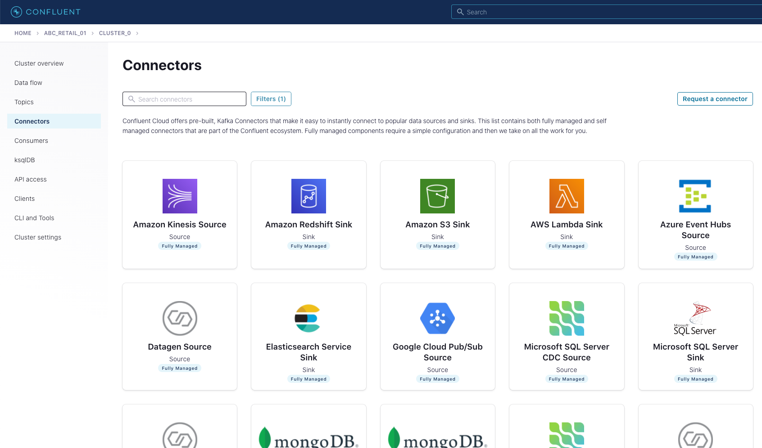
Notes:
There are lots of connectors available on Confluent Cloud.

Slide 17
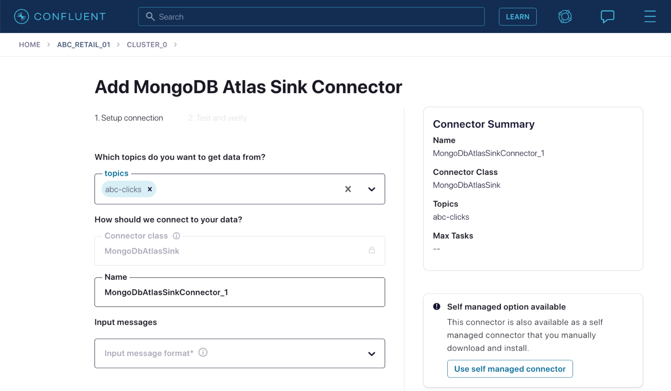

Slide 18
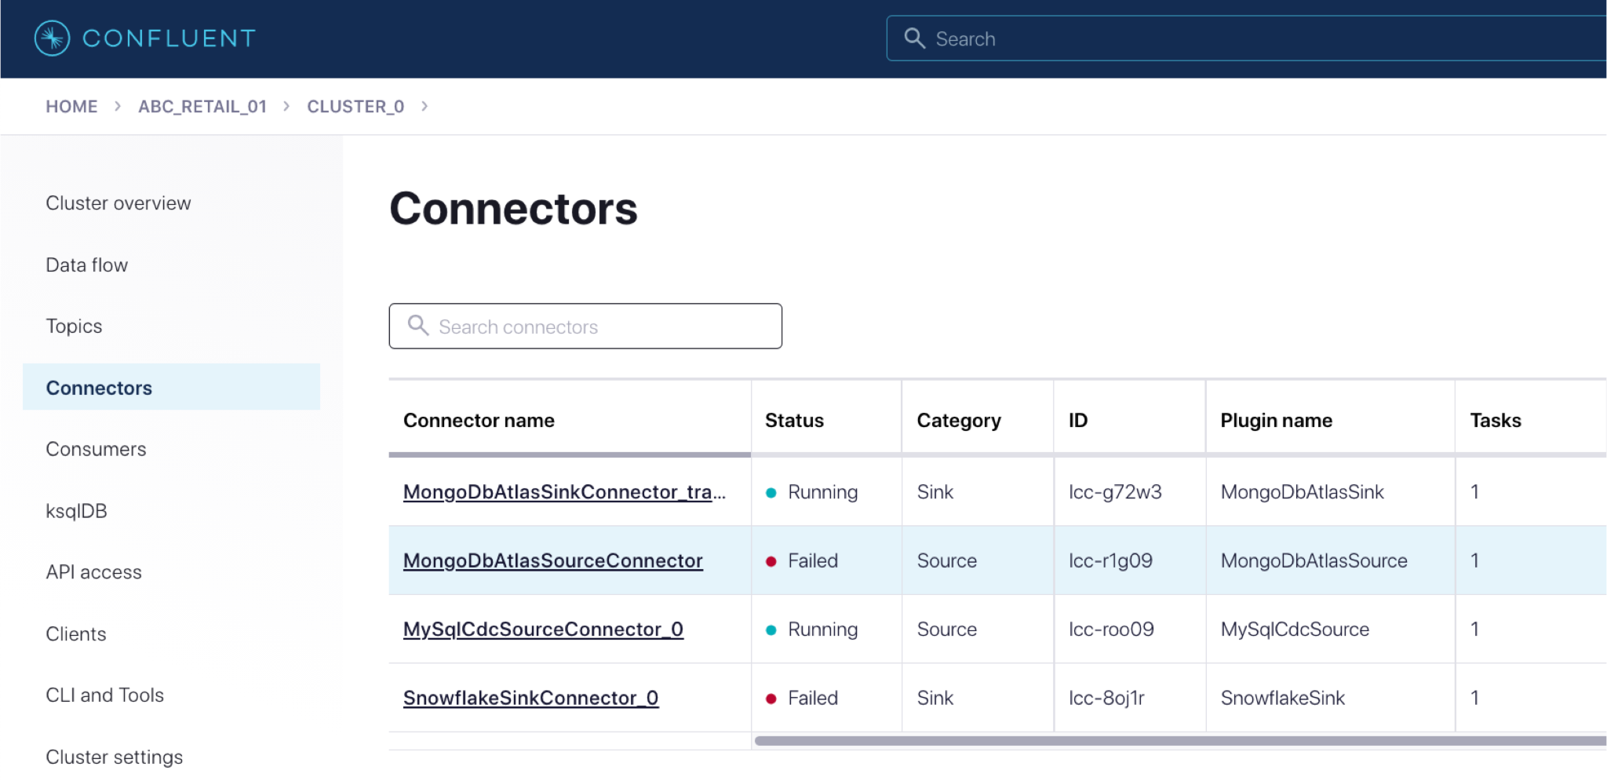
Notes:
…and off you go

Slide 19
KAFKA CONNECT CLUSTER
S3 Task #1
JDBC Task #1
JDBC Task #2
WORKER
WORKER
Notes:
You can also run Kafka Connect yourself. It's a fully distributed system, making it scalable and resilient.
You might choose to run your own Kafka Connect cluster if you also run your own Kafka brokers, or if you are using Confluent Cloud but need a particular connector that's not offered on it yet.

Slide 20
{
"connector.class":
"io.confluent.connect.jdbc.JdbcSourceConnector",
"connection.url":
"jdbc:mysql://asgard:3306/demo",
"table.whitelist":
"sales,orders,customers"
}
Notes:
You can use the Confluent UI to configure Kafka Connect, and you can also use its REST API and send it configuration in JSON.
Whichever way you configure it, and whether you use fully-managed connectors or self-managed, there is no coding required to do integration between Kafka and these other systems — it's just config!

Slide 21
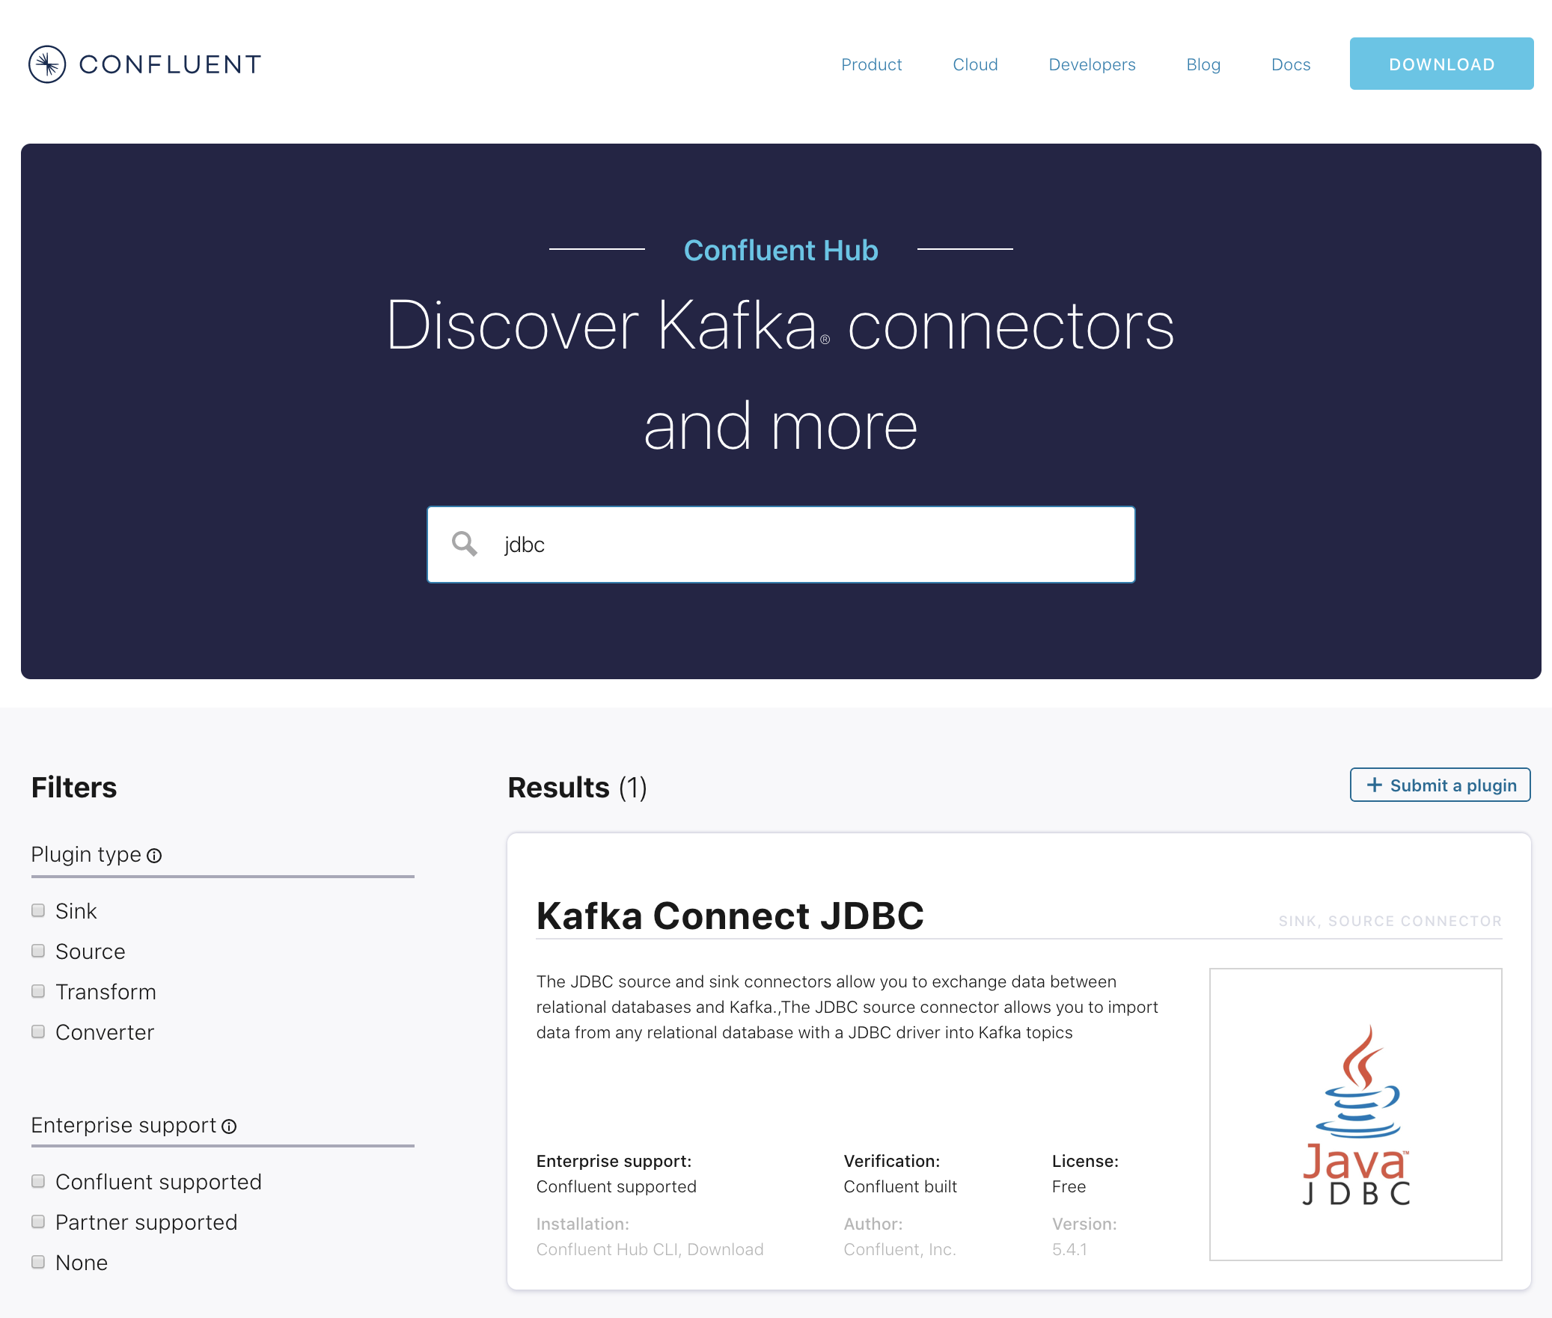
Notes:
If you are running self-managed Kafka Connect, you can find hundreds of connectors at Confluent Hub.

Slide 22
SOURCES
KAFKA CONNECT
syslog
KAFKA BROKERS
Notes:
In this course we're going to concentrate on the pipelines that we can build with Kafka Connect. To learn more about Kafka Connect itself check out the Kafka Connect course that's available on Confluent Developer.

Slide 23
Hands On: Creating a Data Generator with Kafka Connect

Slide 24
Hands On: Creating a Data Generator with
Kafka Connect
Notes:
* create `ratings` topic on ccloud
* create a datagen connector on ccloud
00:00 Create topic
In this exercise you will create a new topic to hold ratings event data, and set up a data generator to populate the topic.
Many connectors can create a topic themselves, but we want to make sure it has certain properties, like the number of partitions
Click on the Topics screen and Add topic
Call the topic ratings and make sure that the number of partitions is set to 6 (which is the default)
00:39 Create datagen connector
Now we can create our first connector. This is one which is just a data generator, rather than a "real" connector to an external system (we’ll use one of those in the next module)
Search for datagen in the connectors and click on the tile when you find it
01:01 API keys
For connectors to access the Kafka cluster they need to have an API key. You can use an existing one, or create one here. We’ll do that now.
Click on Generate Kafka API key & secret and make a note of the key & secret given. Put in a sensible label for it.
01:22 Configuring the connector
Now fill out the rest of the configuration for the connector
We want to write the messages generated into the ratings topic that we created previously
Kafka itself just stores key/value bytes, and we need to decide how to serialise it. Avro is a great choice because the schema gets retained making the data nice and easy to use downstream
Now we get into the connector-specific configuration. We are going to use the ratings quickstart (other ones generate different datasets), and generate new messages every second
Last up, set one task for the connector, which is plenty for what we are doing here
Click Next
01:52 Review config & Launch
On the next screen check that the JSON configuration that’s been generated matches what you’re expecting, and then click the Launch button to launch the connector
The connector will take a few moments to provision. Make yourself a cup of tea whilst you wait, or drum your fingers impatiently. Or hey, why not go and check out the latest episode of Streaming Audio
You can click on the connector name to see more detail about the connector, including its status which will transition to Running once it’s, well, Running
02:25 View messages
With the connector running, head over to the topics screen again and click on the ratings topic.
Click on the messages tab and you should see messages arriving on the topic in front of your very eyes
Don’t worry about the weird characters in this - it’s just down to how the UI displays them. The data itself is safe and we’ll get to view it proper later in the lesson
You can also check out the data lineage feature if it’s enabled on your cluster. At the moment it doesn’t show so much because we’ve got one source and one target, but as we build the example out you’ll see how this feature in particular is really useful for visualising what’s going on.

Slide 25
Ingest Data from Databases into Kafka with Change Data Capture (CDC)
Notes:
Make it clear that entire contents of table plus all subsequent changes can be captured into Kafka
Kafka Connect is for integration. There are several connectors for DB What is Log-based CDC (JDBC source connector)
What is Query-based CDC (Debezium source connector)

Slide 26
{
"rating_id": 5313,
"user_id": 3,
"stars": 4,
"route_id": 6975,
"rating_time": 1519304105213,
"channel": "web",
"message": "worst. flight. ever. #neveragain"
}
RATING EVENTS
APP
{
"user_id": 3,
"name": "Joanna Smith",
"email": "j.smith@foo.com",
"vip_status": "platinum"
}
User Data
Notes:
We saw previously the outline of the data sources that we're going to use in our pipeline. We set up a datagenerator to create the `ratings` events

Slide 27
{
"rating_id": 5313,
"user_id": 3,
"stars": 4,
"route_id": 6975,
"rating_time": 1519304105213,
"channel": "web",
"message": "worst. flight. ever. #neveragain"
}
RATING EVENTS
APP
{
"user_id": 3,
"name": "Joanna Smith",
"email": "j.smith@foo.com",
"vip_status": "platinum"
}
User Data
Notes:
Now let's see about getting the reference information about the customers who are leaving these ratings from our database
we'll use something called Change-Data-Capture (often called CDC) plus snapshots which enables us to capture everything already in the database, along with new changes made to the data

Slide 28
Notes:
There are two flavours of CDC:
* Query-based CDC
* Log-based CDC
Which one you should use depends of several factors, which we'll discuss here. First off, we need to understand a little bit about how each one works.

Slide 29
SELECT *
FROM my_table
WHERE ts_col > previous ts
Notes:
Query-based CDC uses a database query pull new data from the database
The query will include a predicate to identify what has changed. This will be based on a timestamp field, or an incrementing identifier column (or both)

Slide 30
Notes:
Here's an example of how that works.
There are two rows of data in the database to start with
There are two flavours of CDC:
* Query-based CDC
* Log-based CDC
Which one you should use depends of several factors, which we'll discuss here. First off, we need to understand a little bit about how each one works.

Slide 31
SELECT *
FROM my_table
WHERE ts_col > previous ts
Notes:
The first time the query runs, it's going to capture everything.
Two events are written to Kafka, holding the data from the two rows in the database
There are two flavours of CDC:
* Query-based CDC
* Log-based CDC
Which one you should use depends of several factors, which we'll discuss here. First off, we need to understand a little bit about how each one works.

Slide 32
SELECT *
FROM my_table
WHERE ts_col > previous ts
Notes:
Now a new row is written to the database
There are two flavours of CDC:
* Query-based CDC
* Log-based CDC
Which one you should use depends of several factors, which we'll discuss here. First off, we need to understand a little bit about how each one works.

Slide 33
SELECT *
FROM my_table
WHERE ts_col > previous ts
Notes:
The query polls the database again and this time returns only the row with a timestamp greater than the time at which the query last ran
A new event is written to Kafka holding the data from the row that was added to the database
There are two flavours of CDC:
* Query-based CDC
* Log-based CDC
Which one you should use depends of several factors, which we'll discuss here. First off, we need to understand a little bit about how each one works.

Slide 34
Notes:
The Kafka Connect JDBC Source connector from Confluent is what you would usually use for query-based CDC.

Slide 35
#051024 17:24:13 server id 1 end_log_pos 98
# Position Timestamp Type Master ID Size Master Pos Flags
# 00000004 9d fc 5c 43 0f 01 00 00 00 5e 00 00 00 62 00 00 00 00 00
# 00000017 04 00 35 2e 30 2e 31 35 2d 64 65 62 75 67 2d 6c |..5.0.15.debug.l|
# 00000027 6f 67 00 00 00 00 00 00 00 00 00 00 00 00 00 00 |og..............|
# 00000037 00 00 00 00 00 00 00 00 00 00 00 00 00 00 00 00 |................|
# 00000047 00 00 00 00 9d fc 5c 43 13 38 0d 00 08 00 12 00 |.......C.8......|
# 00000057 04 04 04 04 12 00 00 4b 00 04 1a |.......K...|
Notes:
Log-based CDC works a bit differently. It uses the database's transaction log to extract details of every change made.
The particular transaction log implementation and specifics are going to vary per database, so what I'll describe here is broadly how all this works -- enough information to help inform your choice about which CDC method to use.

Slide 36
Transaction Log
Notes:
The transaction log (known in various different implementations as the redo log, binlog, etc) is written to with every change made in the database.
This includes inserts, updates — even deletes
So when two rows are written to the database, two entries are added to the transaction log

Slide 37
Transaction Log
Notes:
Those two entries from the transaction log are decoded and the actual data from the database row is written to two new messages in Kafka
The cool thing about log-based CDC is that it can capture not just what the table rows look like now, but also what they were before they changed.

Slide 38
D
Transaction Log
Notes:
This has a ton of uses, and is one of the reasons why people choose log-based CDC over query-based CDC

Slide 39
D
D
Transaction Log
Notes:
This has a ton of uses, and is one of the reasons why people choose log-based CDC over query-based CDC

Slide 40
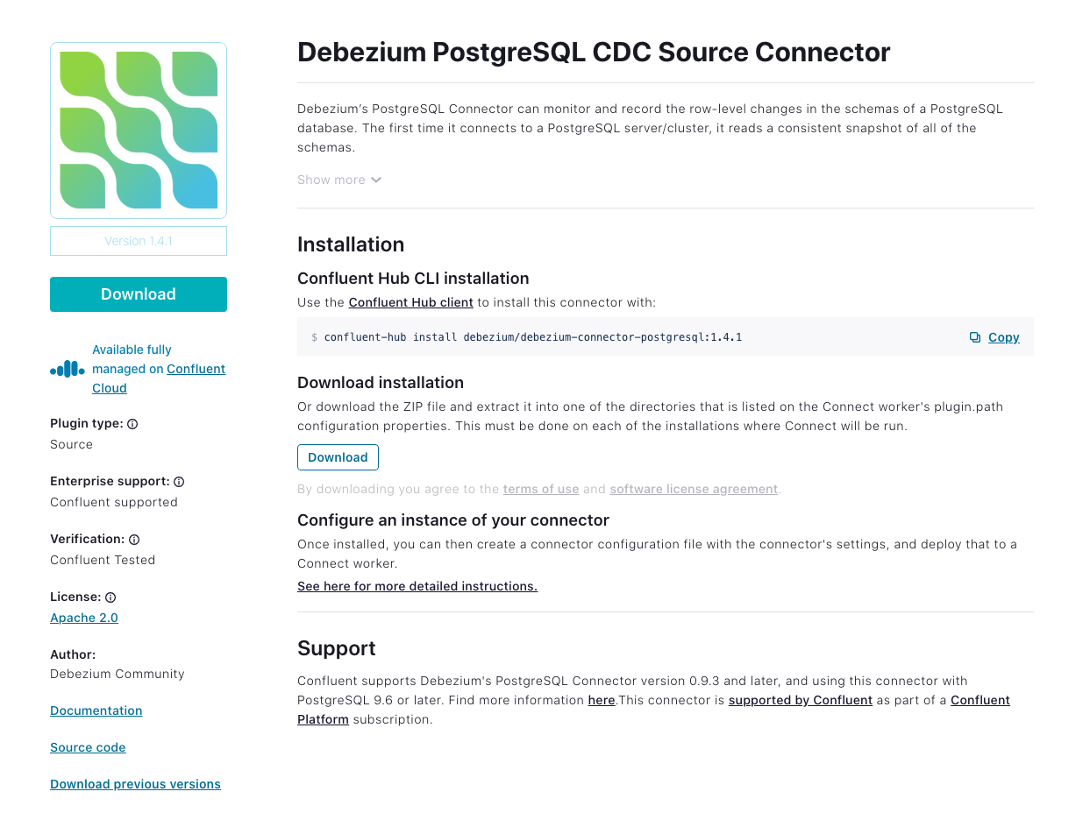
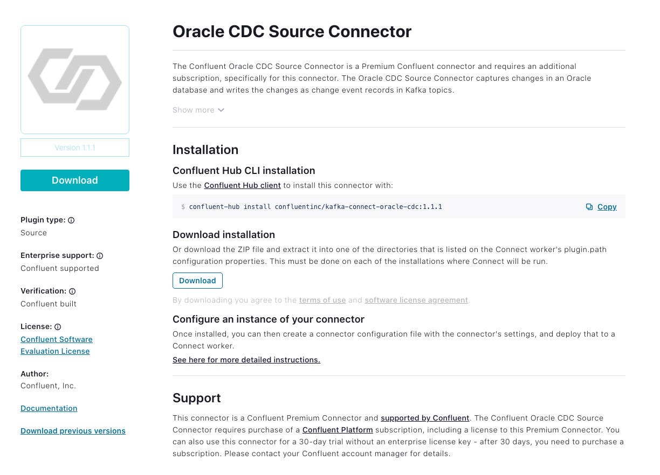
Notes:
Two examples of log-based CDC connectors are the Confluent Oracle CDC connector, and the connectors from the Debezium project which support several databases including Postgres, MySQL, and SQL Server

Slide 41
How to Choose the Right CDC Method for Getting Data from RDBMS
into Kafka
Notes:
Get the viewer to appreciate that there are two types of CDC and they need to choose which to use
How to choose (it depends, Obv)

Slide 42
Query-Based CDC
Usually easier to setup
Requires fewer permissions
Needs specific columns in source schema to track changes
Impact of polling the DB (or higher latencies tradeoff)
Can't track deletes
Can't track multiple events between polling interval
Notes:
+ Usually easier to setup - it's just a JDBC connection to your database, just like running a JDBC query from your application or favourite database dev tool
+ Requires fewer permissions - you're only querying the database, so just need a regular read-only user with access to the tables
- Needs specific columns in source schema to track changes - if you don't have the option to modify the schema to include a timestamp or incrementing ID field then life becomes somewhat difficult
Impact of polling the DB (or higher latencies tradeoff) - if you run the same query too often against the database you're going to have—quite rightly—your DBA on the phone asking what's going on. But set the polling too infrequently and you end up with data that is potentially of less use because of its age
Can't track deletes - you can only query a database for data that's there. If the data's been deleted, you can't query it, and so you can't capture that event into Kafka
Can't track multiple events between polling interval - if a row changes several times during the period in which the connector polls, you'll only capture the latest state. In some cases, this may not matter (if you just want the latest state of a table). In others, it can matter a lot (if you're building applications that are to be driven by changes happening in the database)

Slide 43
Log-Based CDC
Greater data fidelity
Lower latency
Lower impact on source
More setup steps
Higher system privileges required
Notes:
Greater data fidelity - everything is captured - inserts, updates, even deletes —and for each of these, we can get the previous state of the row that changed too
Lower latency and lower impact on source - because we're not polling the database but reading the transaction log, it's lower latency - and we're also putting less load on the database too
More setup steps, and Higher system privileges required - the transaction log is a relatively low-level component of the database, so we need greater privileges in the database to access the API for it, and it can be more complicated to setup.

Slide 44
Hands On: Loading Data from MySQL into Kafka with Kafka Connect

Slide 45
Hands On: Loading Data From MySQL into
Kafka with Kafka Connect
Notes:
00:00 View the customer data in MySQL
In this exercise we’ll ingest information about the customers who are writing the rating messages created in the previous exercise. The customer data is held in a MySQL database.
Before we ingest the data into Kafka from the database, check that the database has been set up with the data correctly
Now head over to Confluent Cloud
00:24 Create topic
From the topics page create a new topic into which the customer data will be written
Make sure you use the name specified, and that 6 partitions are set
We want to override one of the settings so click Customise settings and set Cleanup policy to Compact
Click Save & Create
01:06 Create connector
Search for MySQL CDC connector
Make sure it’s the MySQL CDC Source and not MySQL Source (naming things is hard)
Click the connector to go to the config page
Use the same API details as you did for the datagen connector. If you’ve lost these details then you can create a new one (but there is a ceiling on how many you can create, so don’t do this if you can avoid it)
Enter the database’s connection details. Make sure that the database can accept inbound connections from the internet, otherwise this isn’t going to work
The database server name is an arbitrary label, but is used in the topic’s name so if you deviate from this you’ll need to amend the name of the topic that you created above
Enter the name of the table to create, and some more config details (there’s nothing else particular to note)
02:35 Validate & launch connector
Click Next, at which point the connectivity to your database will be checked. If it fails, make sure that the database is open to the internet, and that your connection details are correct
Review the JSON config against what you entered, and click Launch. If it all looks ok
As with the data generator connector, you have to wait for it to provision, which can take a couple of minutes
Once it’s running you’ll get the tell-tale "Running" status shown for it
03:30 Checking the ingested data
With the connector running, head to the Topics page
Find the CUSTOMERS topic and click on it and through to the Messages screen
The messages screen will be empty, which is disconcerting. Because the data’s already been ingested by this point, there are no new messages arriving (which is what this screen shows by default)
To view the data that’s already there, click the offset menu and enter an offset (e.g. zero) and select a partition (e.g. zero also).
You should then see the data that’s come in from the database. As before it’s got "weird" characters in it, but also as before, that’s nothing to worry about, it’s just a UI thing.

Slide 46
Filtering Streams of Data
with ksqlDB
Notes:
Show how easy it is to process data in Kafka using SQL Introduce viewer to basics of ksqlDB
[ based on https://github.com/confluentinc/demo-scene/blob/master/build-a-streaming-pipeline/demo_build-a-streaming-pipeline.adoc#part-01-ksqldb-for-filtering-streams ] Create a stream over the source ratings data Create a new stream that excludes test data Explain basic concepts of streams and CSAS along the way

Slide 47
Easily Build
Real-Time Apps
ksqlDB
Apache Kafka®
ksqlDB at a Glance
ksqlDB is a database for building real-time applications that leverage stream processing
Compute
Storage
Joins
Aggregates
CREATE TABLE activePromotions AS
SELECT rideId,
qualifyPromotion(distanceToDst) AS promotion
FROM locations
GROUP BY rideId
EMIT CHANGES
Push & Pull Queries
Filters
User-Defined Functions
Connectors
Build a complete real-time application with just a few SQL statements
Notes:
So far we've covered the ingest and egress components of streaming pipelines. Let's now look at how we can also process that data as part of the pipeline.
Kafka itself has stream processing capabilities built in, with Kafka Streams. This is great if you're in the Java ecosystem—but plenty of people aren't.
ksqlDB abstracts away the need to write Java code and instead gives you a SQL language to express the stream processing that you'd like to do

Slide 48
Filter Events to a Separate Stream in Real Time
Stream: Test and Live Events
Stream: Blue Events Only
Partition 0
Partition 0
Partition 1
STREAM
PROCESSING
Partition 1
Partition 2
Partition 2
Notes:
In our stream of ratings data there are messages generated by a test system that have crept in
We can identify these by looking at the `channel` field. When it comes to processing the messages we only want to include those which are from production sources

Slide 49
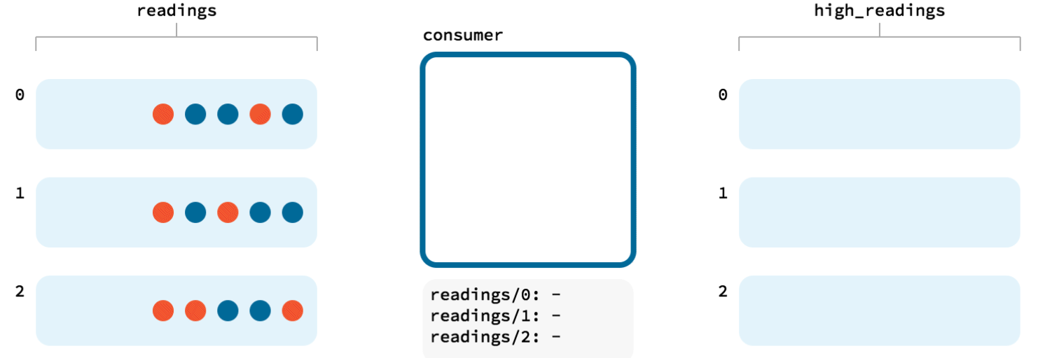
ratings
ratings_live
-- pq1
CREATE STREAM RATINGS_LIVE AS
SELECT *
FROM RATINGS
WHERE LCASE(CHANNEL) NOT LIKE '%test%'
EMIT CHANGES;
Notes:
As each message is read from the source topic ksqlDB applies the predicate against the `channel` field, and only if it does not include `test` within it does the message get written to the target topic

Slide 50
Hands On: Filtering Streams of Data with ksqlDB

Slide 51
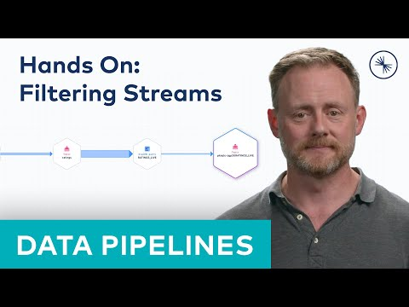
Hands On: Filtering Streams of Data
with ksqlDB
Notes:
Create a stream over the source topic
Create a new stream with no `test` channel messages
https://github.com/confluentinc/demo-scene/blob/master/build-a-streaming-pipeline/demo_build-a-streaming-pipeline.adoc#part-01-ksqldb-for-filtering-streams
00:00 Create stream so that we can filter it
The ratings messages that we receive include a field that indicates the device from which they were left. The field is called channel and includes some values indicating that they’re from test devices. We’re going to set a stream processor which will create a new stream in which only messages that are not test will be included
From your cluster’s main page, launch the ksqlDB application
The first thing to do is create a stream on the ratings topic <explain what a stream is>
Query the stream to see that the data is there. Because there’s a schema we can project specific fields.
Toggle the output to see it as a table. Note the test values in the CHANNEL field.
01:12 Developer a filter for the stream
Let’s use some SQL now to filter the data
We use a WHERE clause to define the predicate
Force the channel field value to lowercase, and then compare it to the wildcard pattern
Run the query and see how the CHANNEL values are now only those which don’t have test text in them
01:35 Build the stream processing application
Use the SQL you’ve just prototyped in the editor, and with a CREATE STREAM prefix tell ksqlDB to write the results of this to a new Kafka topic
Before we run this query, we’re going to tell ksqlDB to read all the data from the beginning of the topic by setting auto.offset.reset to earliest
Now click on Run query to create the query
02:00 Check the new stream of data
Now that we have a new stream, we can query it just like the original ratings one
The difference this time is that the messages on it are only those which aren’t test messages
02:15 Check the Kafka topic and data lineage
We can reassure ourselves that the ksqlDB stream we created is populating a new Kafka topic
Head to the topics page and note (03:18 that there RATINGS_LIVE topic exists, with a prefix)
Click on the topic and if you have data lineage on your environment view the flow of data from data generator, into the source topic, processed by ksqlDB, and into a new topic

Slide 52
Joining Data Streams
with ksqlDB
Notes:
[https://github.com/confluentinc/demo-scene/blob/master/build-a-streaming-pipeline/demo_build-a-streaming-pipeline.adoc#part-03---ksqldb-for-joining-streams plus part-02 for the table stuff] Create a ksqlDB table on the database-sourced topic Talk about table vs stream and show the difference Do a stream-table join, and then persist it with CSAS Talk briefly about table-table, stream-stream, n-way joins too but just to mention that they exist

Slide 53
Building State from a Stream
ksqlDB Stream
ksqlDB Table
Customer | VIP Status
Allison | Bronze
Customer | VIP Status
Allison | Bronze
Unbounded Stream of Events
Current State for a Given Key
Notes:
In previous modules we built up the ingest of data into Kafka.
We've got ratings events from our customers telling us what they liked—or didn't—about our products. In reality this would come from a producer API directly, but we're simulating it with a data generator in Kafka Connect
To find out more about who those customers are we're pulling in a mirror of the customer table from a database into Kafka, using Kafka Connect
Now let's see how we can use that data from the database within Kafka to enrich the rating events as they arrive
Kafka topics are streams of events, as are ksqlDB streams. They're unbounded, and each message gives us some information, usually tied to a key
We can use streams to build state, which we're going to call a table
As each event arrives on the stream, we capture its value for the key. In this example here the key is the customer name, and the value is their current VIP status
So Allison is a customer and has just been moved to Bronze VIP status, so we have an event on the Customer stream (which comes from the database by the way). The table also now holds this information

Slide 54
Building State from a Stream
ksqlDB Stream
ksqlDB Table
Customer | VIP Status
Allison | Bronze
Rick | Silver
Customer | VIP Status
Allison | Bronze
Rick | Silver
Unbounded Stream of Events
Current State for a Given Key
Notes:
Another customer is created in the source database.
The event comes through on the customers topic into the ksqlDB stream.
Rick is a Silver VIP status customer. A second entry is created in the table.
At the moment the table looks just like the stream. each event has a corresponding entry in the table.

Slide 55
Building State from a Stream
ksqlDB Stream
ksqlDB Table
Customer | VIP Status
Allison | Bronze
Rick | Silver
Rick | Platinum
Customer | VIP Status
Allison | Bronze
Rick | Platinum
Unbounded Stream of Events
Current State for a Given Key
Notes:
Now the system updates and an event is written to the customers stream in which Rick has been promoted to Platinum status! Lucky Rick!
Because the message key is the customer name and this is an event for an existing key, the table now diverges from the stream
Whilst the stream tells us what happened, the table tells us the current state
The current value for the customer key "Rick" is Platinum. That's what the table's telling us.

Slide 56
Building State from a Stream
ksqlDB Stream
ksqlDB Table
Customer | VIP Status
Allison | Bronze
Rick | Silver
Rick | Platinum
Allison | Silver
Customer | VIP Status
Allison | Silver
Rick | Platinum
Unbounded Stream of Events
Current State for a Given Key
Notes:
Fancy that! Allison got promoted too, to Silver
Because the underlying database changed, we get a new message on the customers stream
That new message on the stream drives a change in the table. For the key of "Allison" the value now is Silver

Slide 57
Building State from a Stream
ksqlDB Stream
ksqlDB Table
Customer | VIP Status
Allison | Bronze
Rick | Silver
Rick | Platinum
Allison | Silver
Hugh | Gold
Customer | VIP Status
Allison | Silver
Rick | Platinum
Hugh | Gold
Unbounded Stream of Events
Current State for a Given Key
Notes:
A new customer gets created in the database. Because this is a new key (name=hugh) a new entry is created in the table.

Slide 58
Merge and Join Topics to One Another
Stream: Blue and Red Events
Partition 0
Partition 1
Stream: Blue and Yellow Events
Partition 2
Partition 0
STREAM
PROCESSING
Partition 1
Stream: Green and Yellow Events
Partition 0
Partition 2
Partition 1
Partition 2

Slide 59
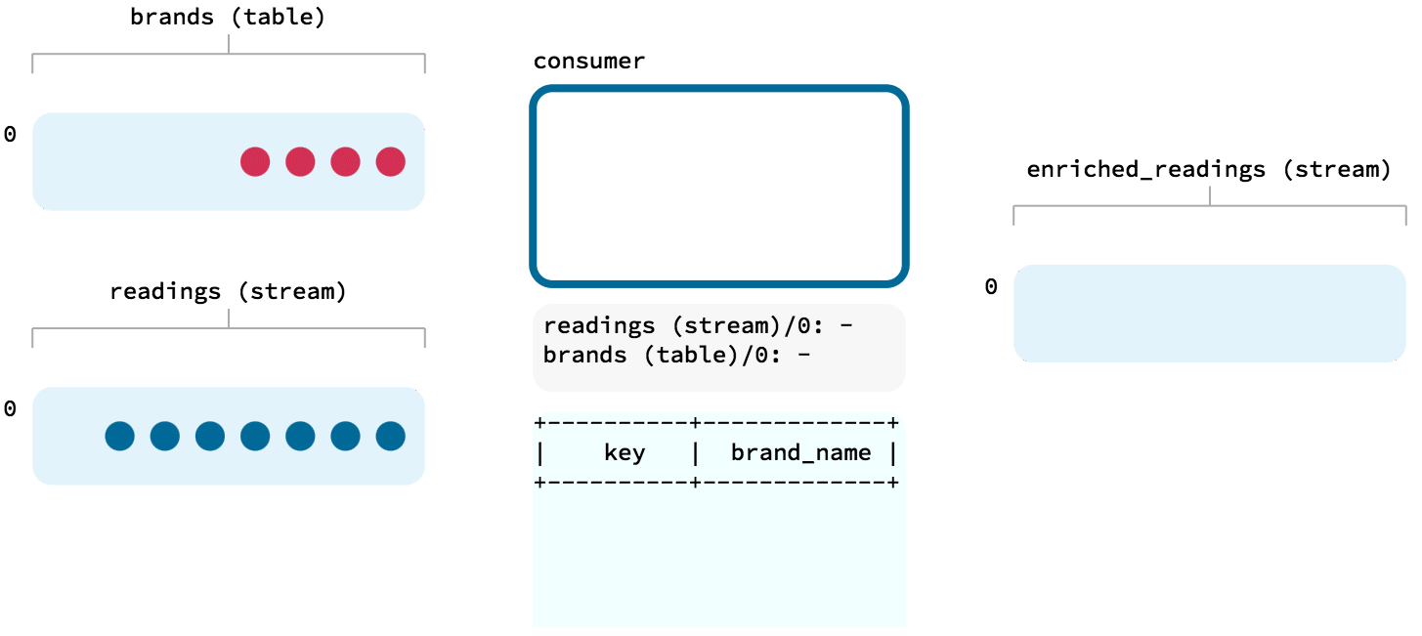
customers
ratings_enriched
ratings
CREATE STREAM ratings_enriched AS
SELECT r.*,
c.*
FROM ratings r
INNER JOIN customers c
ON r.user_id=c.id
EMIT CHANGES;
Notes:
Now that we've seen how ksqlDB can build up state based on a stream, we can look at how to use this for what we need - which is enriching the inbound stream of ratings events with information about the customer who left the rating
It's worth pointing out at this stage that whilst we're talking about ksqlDB, all of these concepts apply to Kafka Streams too (on which ksqlDB is built). So even though I'm showing you ksqlDB streams, ksqlDB tables, you can take the same concepts and just think in terms of KStream and KTables which are the Kafka Streams equivalents.
So, we've got a stream of events (ratings), and a table of state (customer information).
We can use stream processing to do a join between these two. It's called a stream-table join because…we're joining a stream and a table ;) The output of the join is data from the two objects where a match on the common key is found

Slide 60
RATINGS
{
"channel": "web",
"stars": 1,
"user_id": 3,
"message": "need more peanuts"
}
Notes:
So here's our data. The source event is ratings information, with a foreign key of user_id

Slide 61
CUSTOMERS
{
"user_id": 3,
"name": "Joanna Smith",
"email": "j.smith@foo.com",
"vip_status": "platinum"
}
RATINGS
{
"channel": "web",
"stars": 1,
"user_id": 3,
"message": "need more peanuts"
}
Notes:
The customers data acts as a reference, or lookup, table. It's got a primary key of user_id, and then useful information about the customers such as their name, VIP status, and so on

Slide 62
CUSTOMERS
{
"user_id": 3,
"name": "Joanna Smith",
"email": "j.smith@foo.com",
"vip_status": "platinum"
}
RATINGS
{
"channel": "web",
"stars": 1,
"user_id": 3,
"message": "need more peanuts"
}
CREATE STREAM RATINGS_WITH_CUSTOMER_DATA AS
SELECT R.*, C.*
FROM RATINGS C
INNER JOIN CUSTOMERS C
ON R.USER_ID = C.USER_ID;
ksqlDB
Notes:
In ksqlDB we use the standard SQL syntax for expressing a join.
Here we're using an INNER JOIN, which means that only rows from the source that are successfully matched to the table will get written to the output
If we wanted to write all rows to the output regardless of a match to the joined objects then we'd use a LEFT OUTER JOIN.

Slide 63
CUSTOMERS
{
"user_id": 3,
"name": "Joanna Smith",
"email": "j.smith@foo.com",
"vip_status": "platinum"
}
RATINGS
{
"channel": "web",
"stars": 1,
"user_id": 3,
"message": "need more peanuts"
}
CREATE STREAM RATINGS_WITH_CUSTOMER_DATA AS
SELECT R.*, C.*
FROM RATINGS C
INNER JOIN CUSTOMERS C
ON R.USER_ID = C.USER_ID;
ksqlDB
{
"user_id": 3,
"name": "Joanna Smith",
"email": "j.smith@foo.com",
"vip_status": "platinum",
"stars": 1,
"channel": "web",
"message": "need more peanuts"
}
Notes:
The output of the JOIN query gets written to a new ksqlDB stream, which is backed by a Kafka topic.

Slide 64
Hands On: Joining Data Streams
with ksqlDB

Slide 65
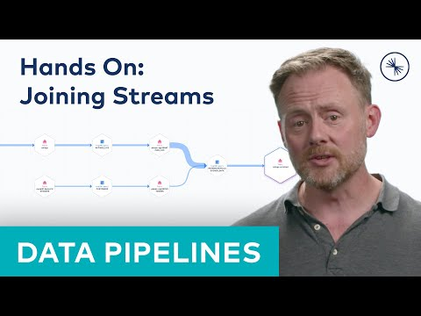
Hands On: Joining Data Streams with ksqlDB
Notes:
Create a ksqlDB table on the database-sourced topic
Talk about table vs stream and show the difference
Do a stream-table join, and then persist it with CSAS
https://github.com/confluentinc/demo-scene/blob/master/build-a-streaming-pipeline/demo_build-a-streaming-pipeline.adoc#part-03---ksqldb-for-joining-streams plus part-02 for the table stuff
00:00 Create customer table
In the previous exercise we filtered a stream of ratings events to create a new one that excluded test messages. Now we’re going to use the customer information that we are pulling in from an external MySQL database to enrich each rating as it arrives (as well as all the existing ratings that we have already received and are storing on the Kafka topic).
To do this we need to first model the customer data held in the Kafka topic in such a way that ksqlDB can use it to join to the ratings events. We’ll do this by creating a ksqlDB table (rather than a stream as done for the events).
0:33 To create a table we’ll first create a stream over the Kafka topic as before
Now we create the table based on the stream. Set the offset to earliest so that we process all the records
The table is built as an aggregation of the stream, using the LATEST_BY_OFFSET aggregation
00:55 Enrich the stream of events
With the table built we can now use it to enrich the ratings stream that we’ve got
We use a stream-table join on the common key of user ID that both the stream and table have
First we prototype the join and make sure that it works and returns the results that we’re expecting
Since the results look good—each rating now includes the information about the customer…
We will now persist this to an new stream (and thus Kafka topic). We do this using CREATE STREAM AS SELECT (like we did for the RATINGS_LIVE stream before)
Note that we’re overriding the default Kafka topic name to a hardcoded value. if we don’t do this the topic takes the name of the stream plus an internal identifier prefix
Let’s check that the new stream works
The results look good - a live stream of events, and as each event arrives, the customer information gets added to it
02:17 Picking up changes in the database
Let’s look at the live ratings stream for a particular user.
Note their current club status (bronze)
Imagine the customer’s status changes. it’s not changed in Kafka - it’s changed in the system in which customer data is created - the database
Probably changed by an application not a manual SQL UPDATE statement in practice…
Note how the next rating that comes in reflects the latest club status for the particular user
03:04 Data flow
ksqlDB has a data flow view which is useful
But if you want broader context, including where the data comes from and goes to, use the data lineage view from the topics screen

Slide 66
Streaming Data from Kafka to External Systems
Notes:
Position Kafka Connect as the primary means for integrating Kafka with external systems Demonstrate the integration with target (Elasticsearch?) in practice
Talk about Kafka Connect and show a ton of the sink connector technology logos / types Refer back to previous module for more of a intro to Kafka Connect, or the Kafka Connect course in full Set up Elasticsearch sink connector Show a nice Kibana dashboard

Slide 67
Amazon S3
syslog
Google BigQuery
Kafka Connect
Kafka
Notes:
As we draw this course to a close we have one final piece to put into our pipeline
We've got the data in, we've processed and enriched it - now let's do something with it and write it somewhere to drive the operational dashboard that we hypothesized about in our example
Just as we used Kafka Connect to get the customer data in from the database earlier, we're going to use Kafka Connect again here to stream the data to the target system

Slide 68
Notes:
There are connectors for most places you'd want to stream data to nowadays - object stores, cloud data warehouses, nosql stores, and so on
We're going to use Elasticsearch, with the managed connector in Confluent Cloud. You can also run it for yourself if you'd rather make life harder for yourself

Slide 69
Notes:
These connectors are fully managed - you just configure them…

Slide 70
SOURCES
KAFKA CONNECT
syslog
KAFKA BROKERS
Notes:
In this course we're going to concentrate on the pipelines that we can build with Kafka Connect. To learn more about Kafka Connect itself check out the Kafka Connect course that's available on Confluent Developer.

Slide 71
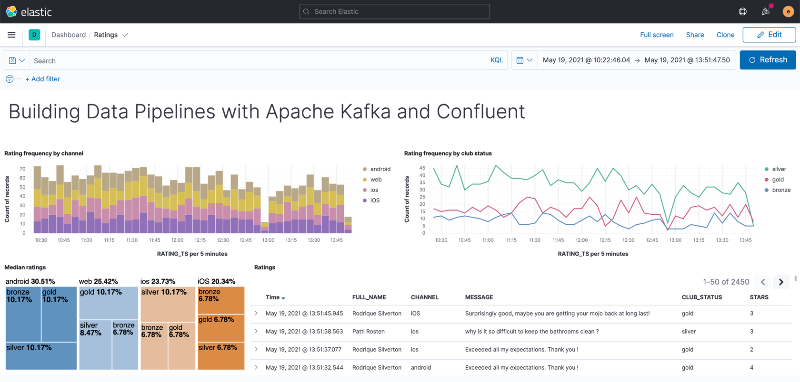
Notes:
With the data flowing into the target system we can then build out the operational dashboard that we had in mind at the beginning of this exercise.

Slide 72
{
"rating_id": 5313,
"user_id": 3,
"stars": 4,
"route_id": 6975,
"rating_time": 1519304105213,
"channel": "web",
"message": "worst. flight. ever. #neveragain"
}
RATING EVENTS
APP
Notes:
Let's recap on what we've built.
We've taken a stream of events, each one with review rating information submitted by a customer

Slide 73
{
"rating_id": 5313,
"user_id": 3,
"stars": 4,
"route_id": 6975,
"rating_time": 1519304105213,
"channel": "web",
"message": "worst. flight. ever. #neveragain"
}
RATING EVENTS
APP
{
"user_id": 3,
"name": "Joanna Smith",
"email": "j.smith@foo.com",
"vip_status": "platinum"
}
User Data
Notes:
We brought in a live copy of the data held in a database about our customers

Slide 74
RATING EVENTS
APP
OPERATIONAL DASHBOARD
User Data
Join Events to Users and Filter
Notes:
and we used stream processing to enrich each rating event as it arrives with information about the customer who left the review
the resulting enriched data was written back into a new Kafka and then streamed to Elasticsearch from where we built a dashboard on it

Slide 75
Hands On: Streaming Data from Kafka to Elasticsearch with
Kafka Connect

Slide 76
Hands On: Streaming Data from Kafka to Elasticsearch with Kafka Connect
Notes:
1. Create Elasticsearch sink connector
2. Build out a dashboard in Kibana
00:00 Background
This exercise is the culmination of a pipeline project which takes streams of ratings events, filters them and enriches them with information about the customer using data streamed from a database.
For the final step we will stream the enriched data out to Elasticsearch from where it can be built into a dashboard. You need to have an Elasticsearch instance created as described in the first exercise, and it must be accessible from the internet.
00:20 From our cluster’s homepage we can head to the topics screen and see the topic we created at the end of this pipeline
There’s new messages arriving in this topic, along with all the ones there already.
Each time someone leaves a new rating on our fictional website it’s received on a Kafka topic, enriched to include information about the customer, and written out to this topic.
We want to build an operational dashboard of these ratings that includes the information about the customer, so let’s stream this data to Elasticsearch
00:44 Create Connector
Head to the connectors page and look for the Elasticsearch Service Sink
Select the ratings-enriched topic. Remember we hardcoded this topic name when we created it in ksqlDB in the previous lessons
Specify the API key so that the connector can access the Kafka cluster. As before, re-use the one you created, but if you’ve lost it create a new one
Specify the endpoint and credentials for your Elasticsearch instance. Remember that it needs to be accessible from the internet
Fill out the rest of the details for how to handle the messages being sent from Kafka to Elasticsearch
Click Next and the connection to Elasticsearch will be validated
Check the JSON against the config that you entered and click Launch to create the connector
01:38 View Connector Details
Once the connector’s running you can click on it and see throughput rate etc
From the cluster menu you can list the consumers and see the connector’s lag against each partition
01:54 Check the Data in Elasticsearch
In kibana we can see the index has been created in Elasticsearch and there are docs in it (Docs count column)
The mappings of the fields looks good, including the RATING_TS as a date type
Create an index mapping in Kibana so that it knows what fields are in the data
Head to Discover feature and add fields to the view
Note how new messages are arriving all the time each time we refresh
Save the view so that you can add it to a dashboard
Create a new dashboard and add the view to it that you just created
<Create new dashboard - LMK if you need words to talk through this but I’m guessing you want to just skim over this bit>

Slide 77
Your Apache Kafka®
journey begins here
developer.confluent.io

